Slide 1
MIMO-SAR mmWave Imaging
Saad (IMT2018514)
Rutvi (IMT2018519)
Srijan (IMT2019524)

Slide 2
Checkpoints
Code Architecture
Import of Data
Mean Target z-Distance
Data Read functions
Calibration of Data
Defining parameters
Multistatic-to-monostatic conversion
Uniform Virtual Array
Reconstruction of the Image
8 parts

Slide 3
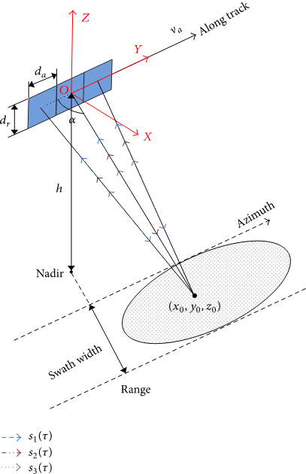
Introduction
RADAR is fundamentally an electromagnetic sensor used to detect and locate objects. Radio waves are radiated out from the radar into free space. Some of the radio waves will be reflected back by the interfering objects (targets). Earlier with the help of the time and speed relation we used to calculate the distance of the object. But, now with advanced hardware (MIMO, in our case) and advance processing algorithm, like RMA. We hit the target with the radio waves from multiple transmitter and process the data of reflected waves to create the exact image of the whole object.

Slide 4
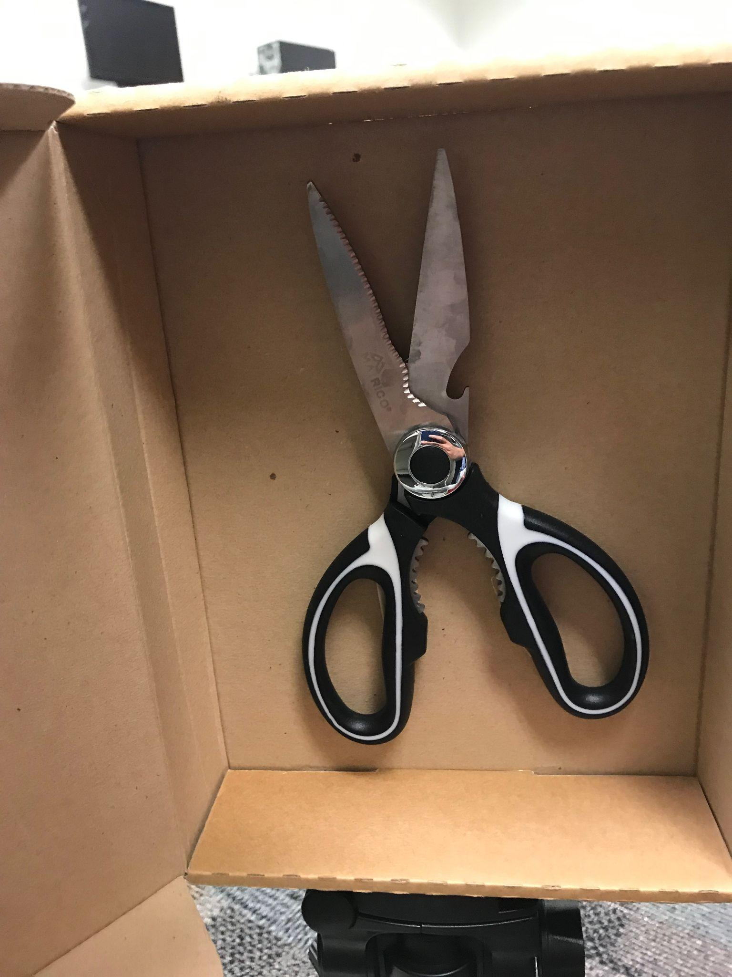
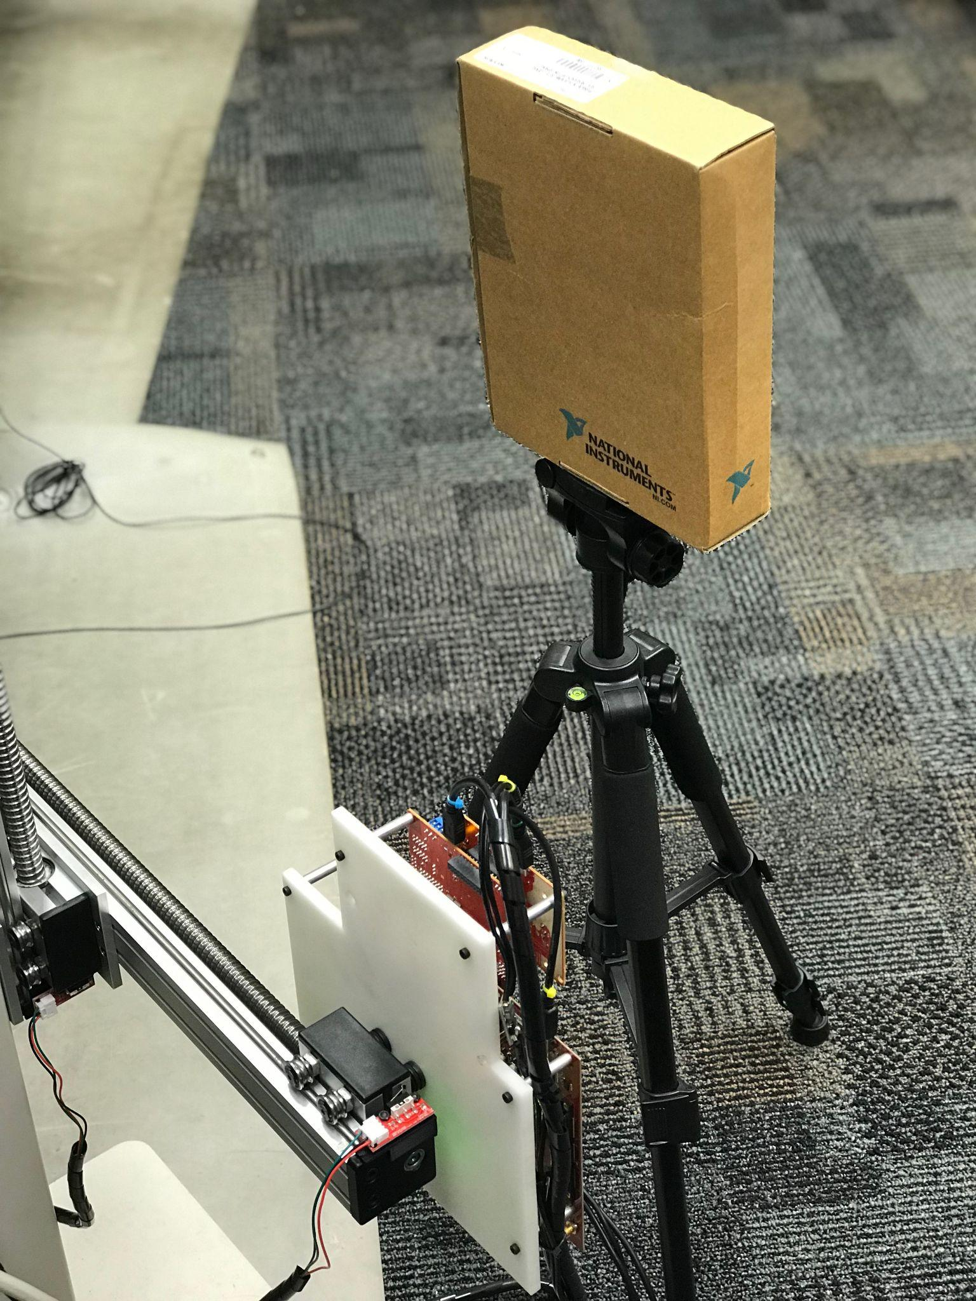
Import of Data
Downloaded sample dataset 20190523_smallPlatform_scissorsInBox_400By400 Loaded and passed to data Read functions. Data corresponds to a scissor in a box, as shown in the images below:

Slide 5
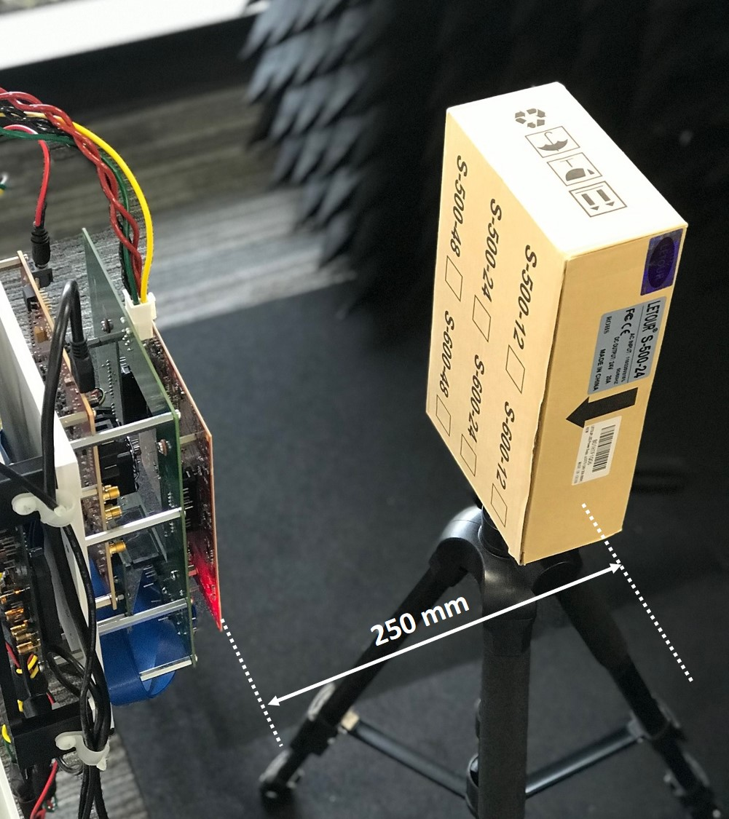
Mean Target Z - Distance
zTarget_mm is 250.
A pair of scissors concealed in a cardboard box is placed at a mean distance of z₀ ≈ 250 mm from the scanner setup.

Slide 6
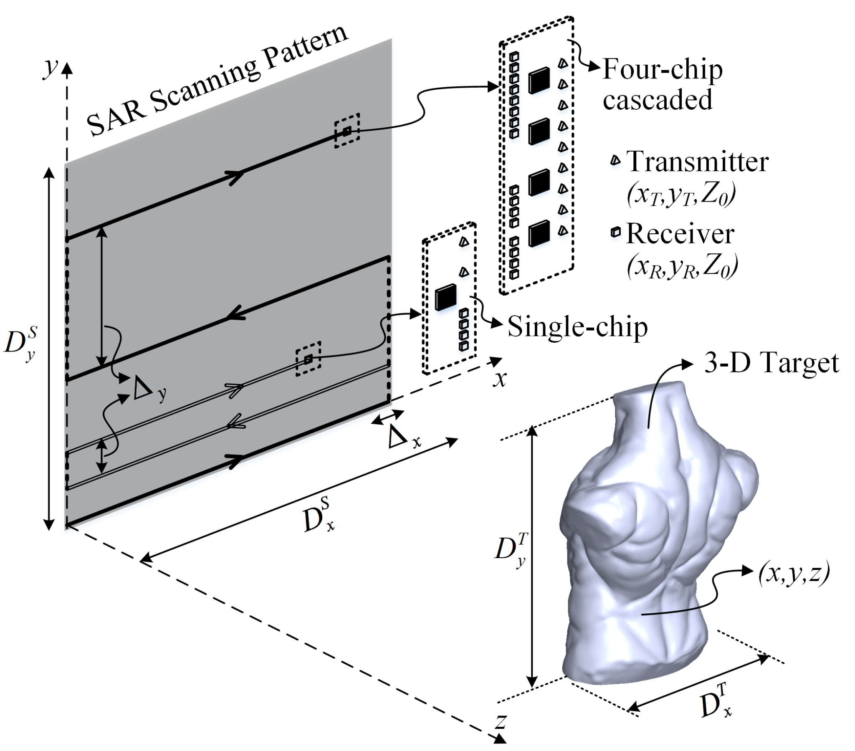
Data Read functions
Check the average chirps flag
Check if the scan mode is Rectangular
Check if the Hardware trigger mode is active
Pre-processing of the Hardware Trigger Data

Slide 7
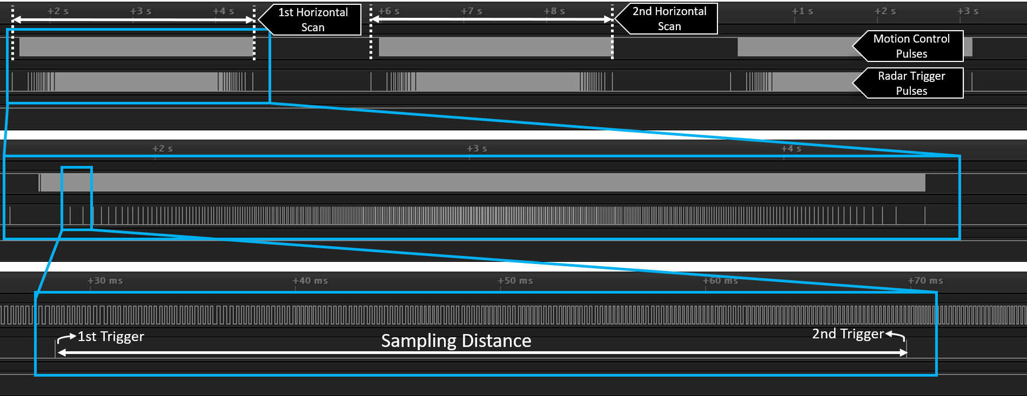
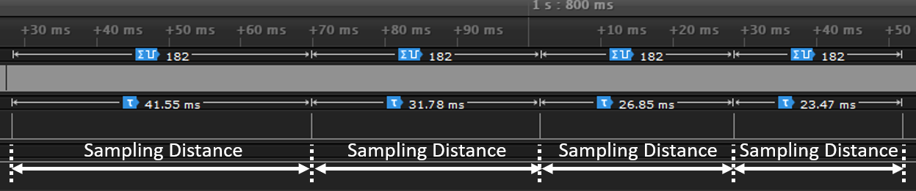

Slide 8
Data Read functions
Parse Complex rawData
Pre-processing based on SAR Mode
For Continuous Scan - Crop the Data
Rearrange the vertical scans
Reshape the rawData

Slide 9
Radar Calibration
Process
MIMO Array Calibration
Measurement errors due to sensor gain and phase mismatches.
These mismatches can be caused by, path length imperfections, chip-to-chip or antenna-to-antenna variations, etc.
Can affect the image reconstruction adversely, and lead to unacceptable defocused blur and range shift in the images.
Hence Calibration is an essential step in MIMO-SAR imaging to reduce the effects of channel variations and to improve the reconstructed image quality.

Slide 10
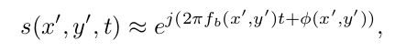
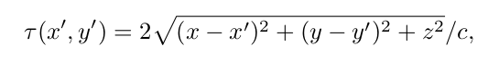
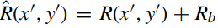
MIMO Array Calibration
Backscattered equation in time domain. (Beat frequency and phase together)
Phase bias: The received function if considered with beat frequency will give limited information as some information is also present in the phase part, to take care of the info. Contained in phase domain we add offset which is part of data calibration.
Range bias:

Slide 11
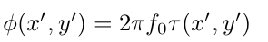
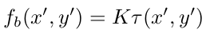
MIMO Array Calibration
Backscattered equation in time domain. (Beat frequency and phase together)
Phase bias Calculations:
Range bias Calculations:

Slide 12
Defining Parameters
Frequency - Start_Freq_GHz*1e9, Slope_MHz_perus*1e12 , Sampling_Rate_ksps*1e-3 , Adc_Start_Time_us*1e-6
Samples_per_Chirp - Samples per chirp Num_TX - Number of transmitters
Num_RX - Number of Receivers Num_horizontalScan - Horizontal scans Num_verticalScan - Vertical scans
lambda_mm = c/79e9*1e3 - center frequency

Slide 13
Defining Parameters
xStepM_mm - Horizontal step size.
yStepM_mm - Vertical step size.
Platform_Speed_mmps - Speed of the Scanner
Frame_Repetition_Period_ms - Frame repetition period

Slide 14
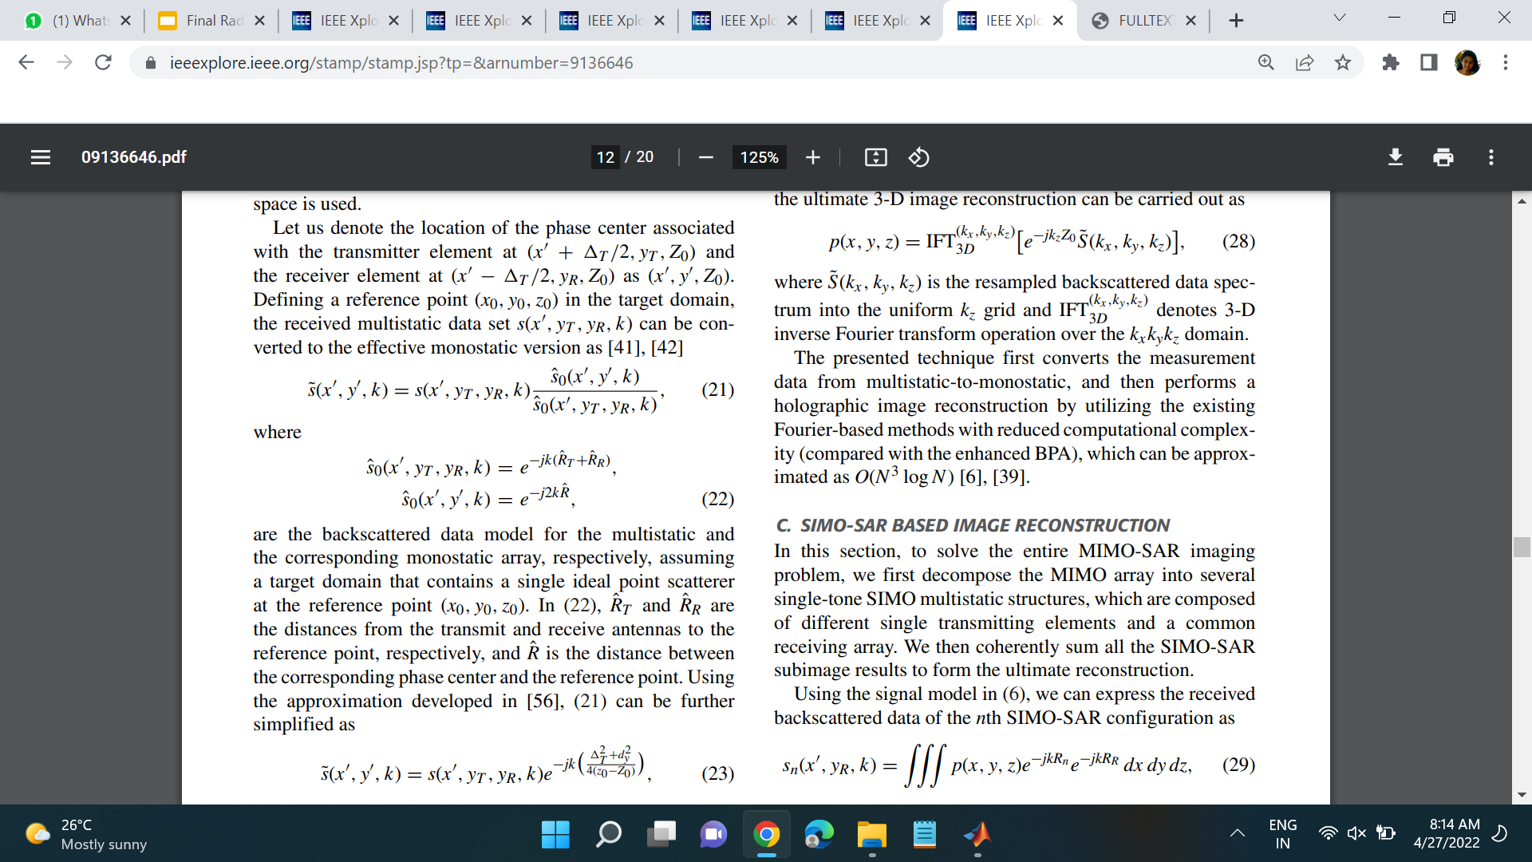
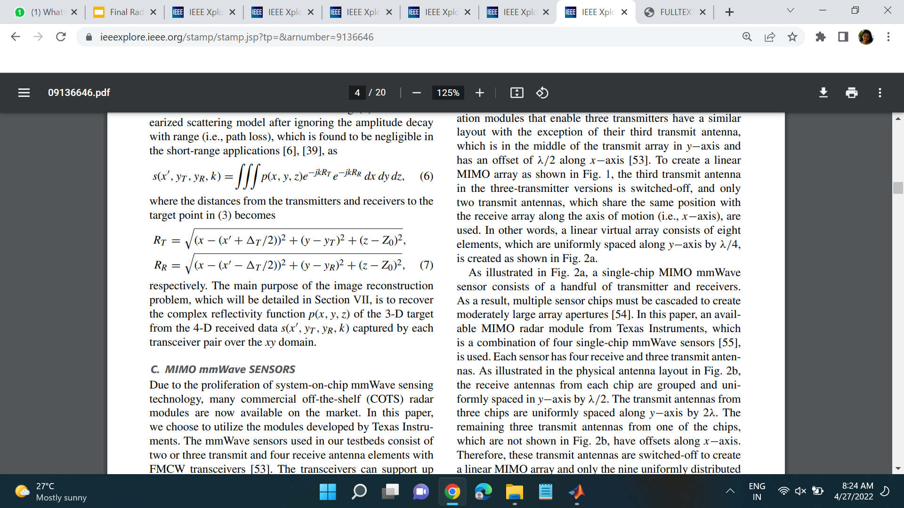
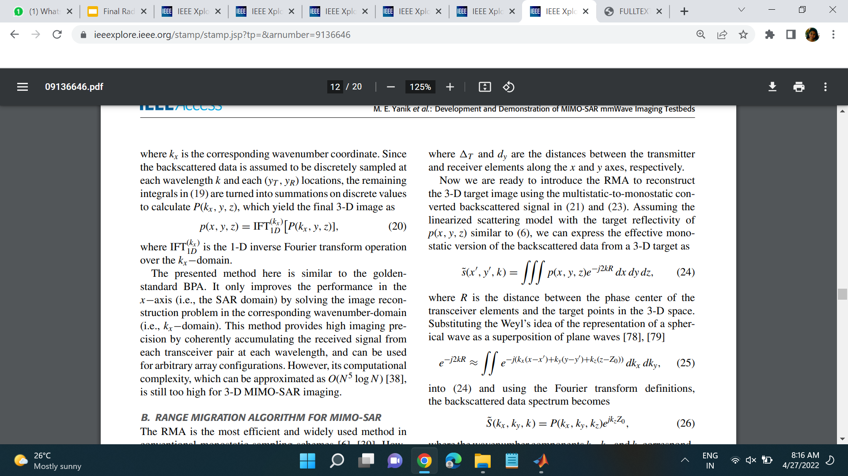
Multistatic-to-monostatic conversion
Phase center associated with the transmitter element at (x₀ + ΔT/2, y_{T} , Z₀) and the receiver element at (x₀ - ΔT/2, y_{R}, Z₀) as (x₀, y₀, Z₀)

Slide 15
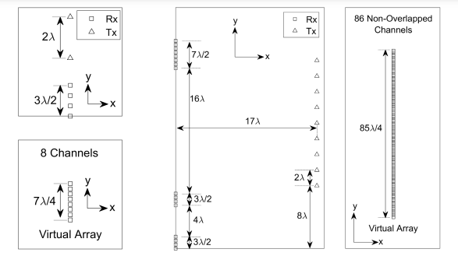
Uniform Virtual Array

Slide 16
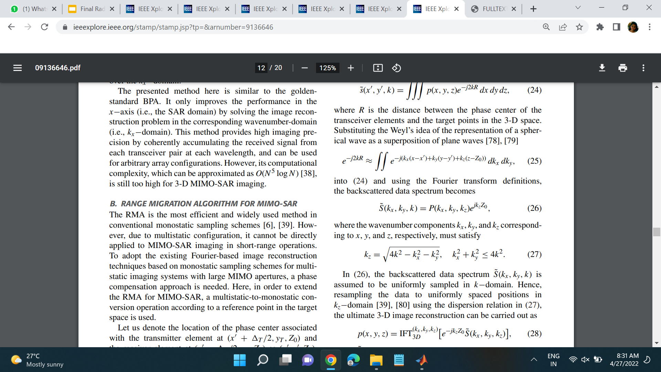
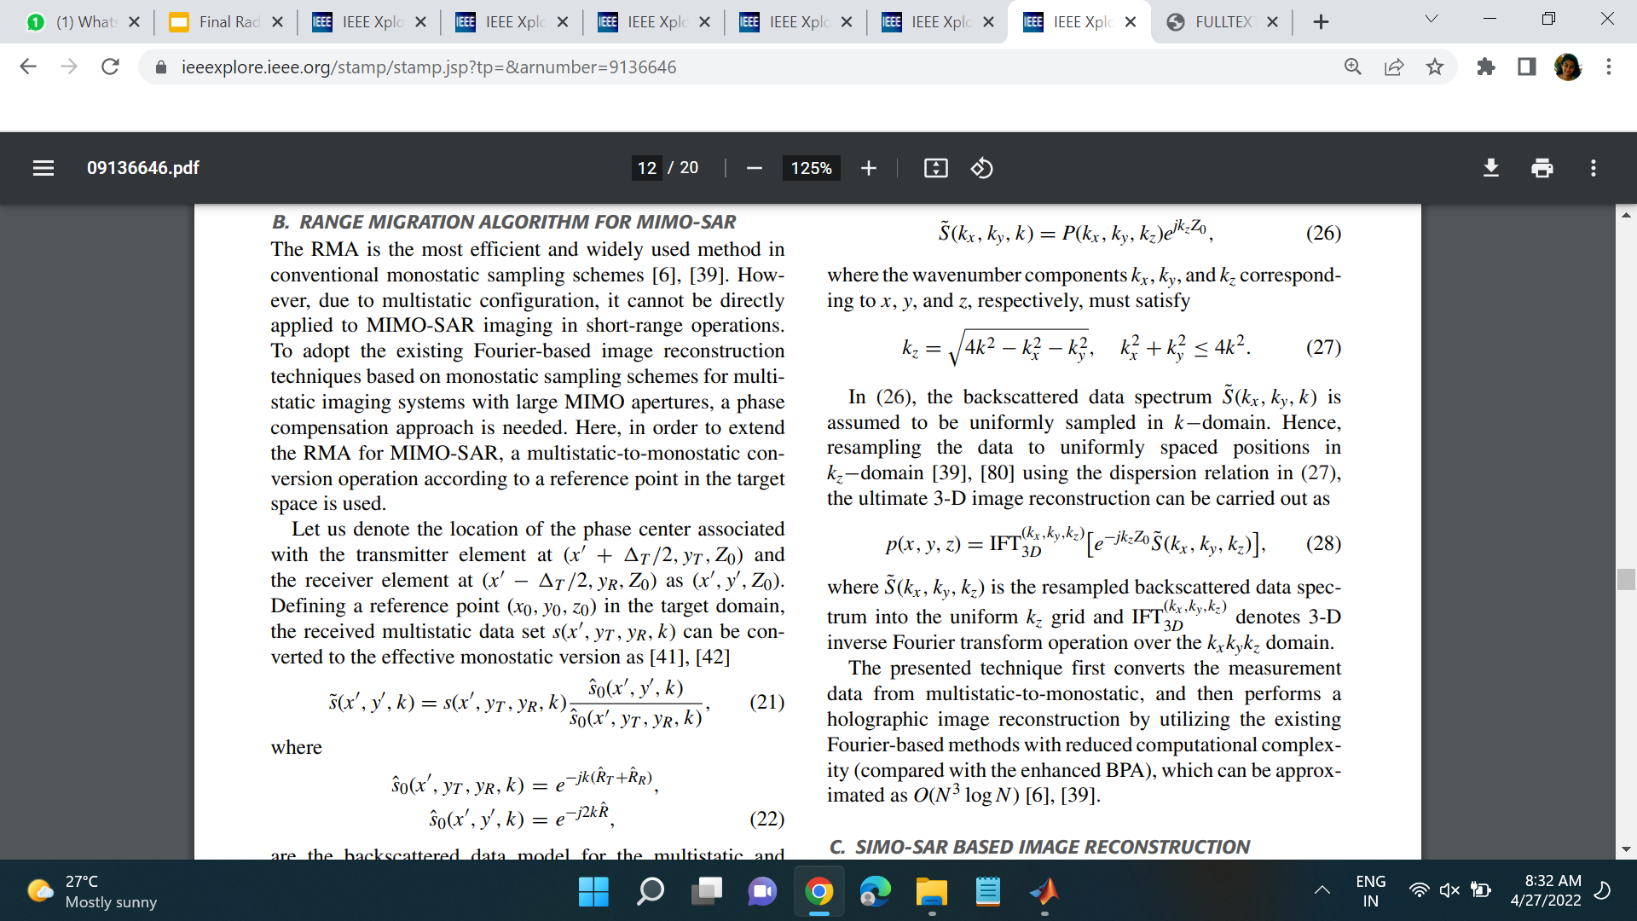

Reconstruction of Image
Representation of a spherical wave as a superposition of plane waves:

Slide 17
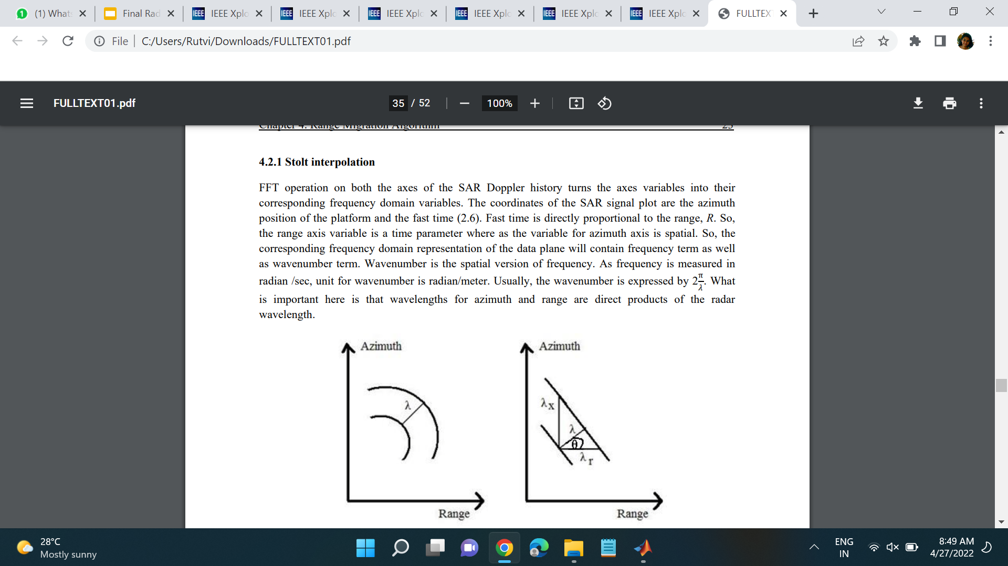
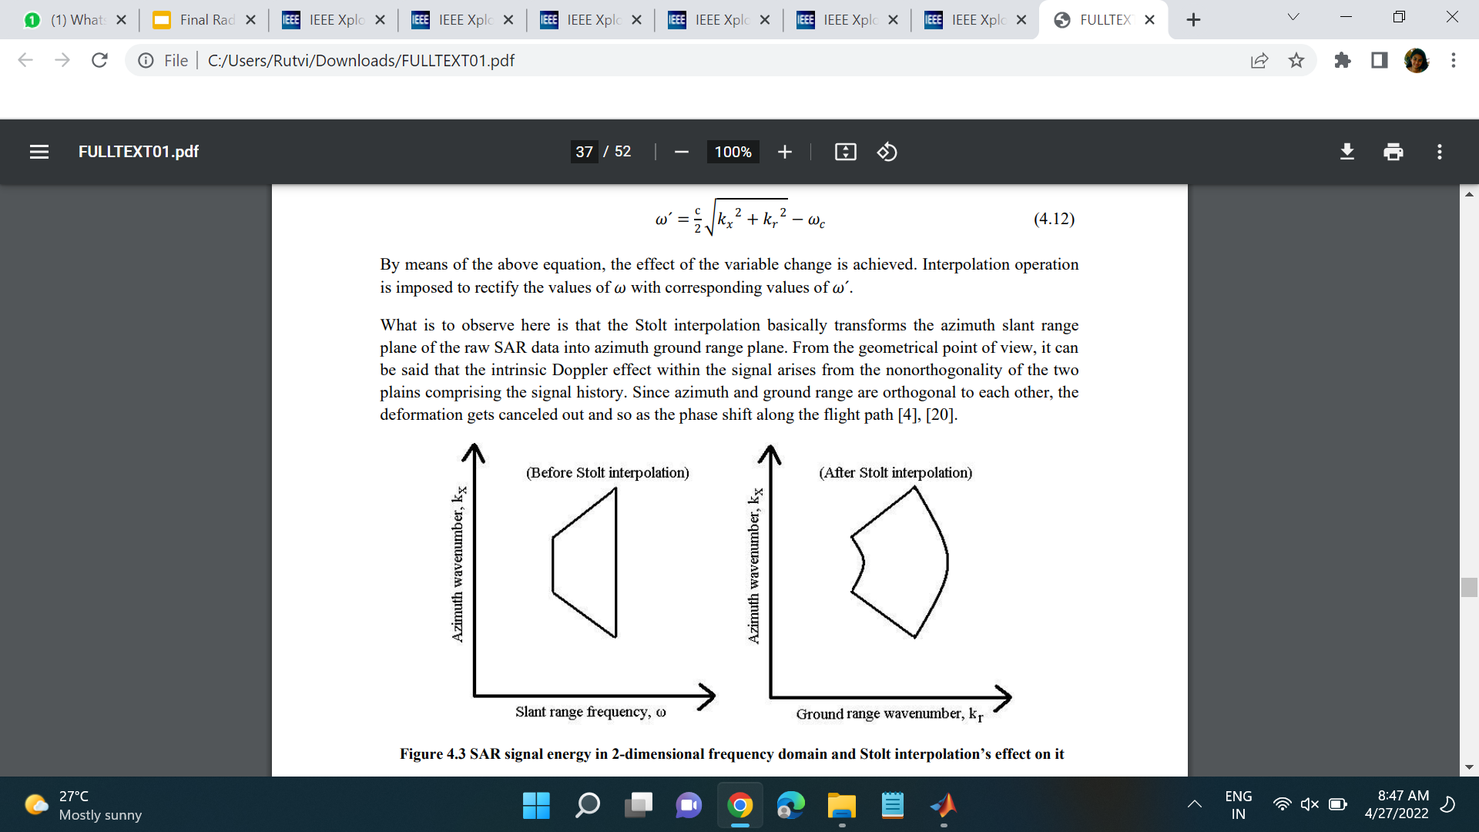
Stolt interpolation and Azimuth compression
Stolt interpolation basically transforms the azimuth slant range plane of the raw SAR data into azimuth ground range plane.
Intrinsic Doppler effect within the signal arises from the nonorthogonality of the two plains comprising the signal history.
Since azimuth and ground range are orthogonal to each other, the deformation gets canceled out and so as the phase shift along the flight path

Slide 18
Thank You.

